Slide 1
Car project
Thijs, Duncan and Dylan

Slide 2
Content
General project overview
Tire-pressure monitor
Telematics
Event data recorder
Body controller
Engine control unit
Infotainment
Questions?

Slide 3
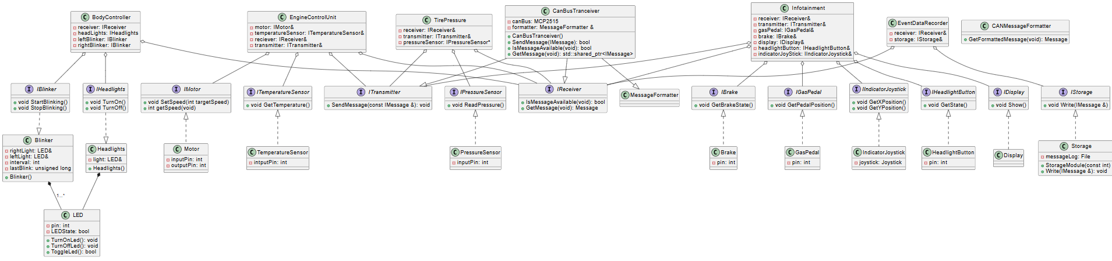
General Project overview

Slide 4
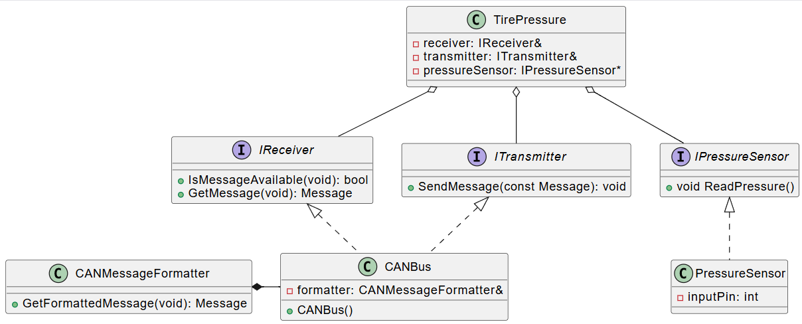
Tire-pressure monitor

Slide 5
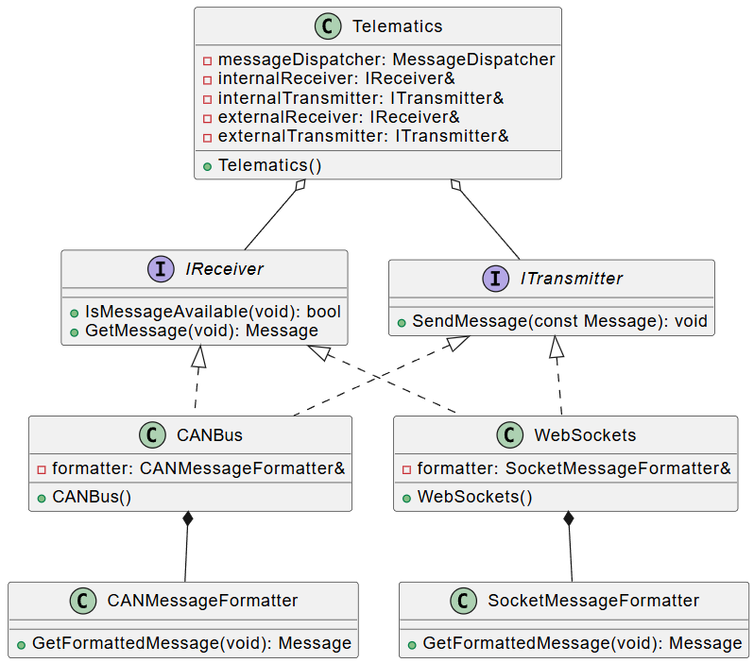
Telematics

Slide 6
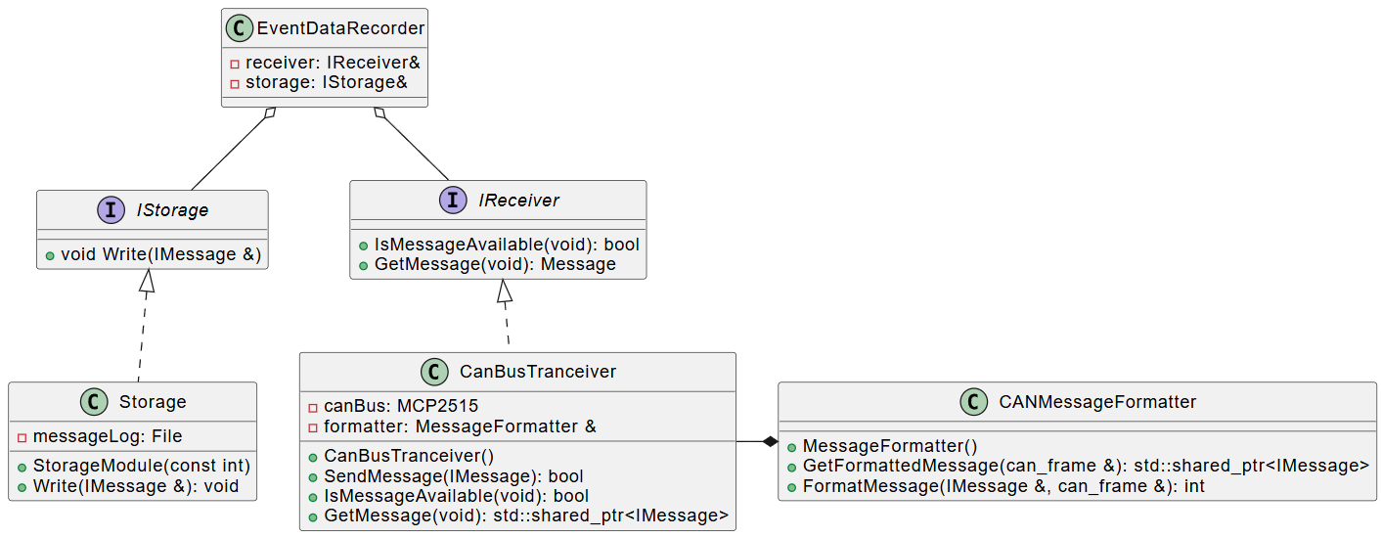
Event date recorder

Slide 7
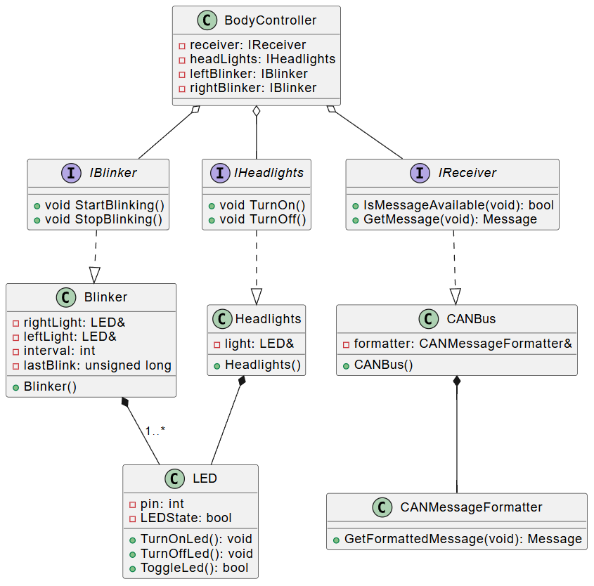
Body controller

Slide 8
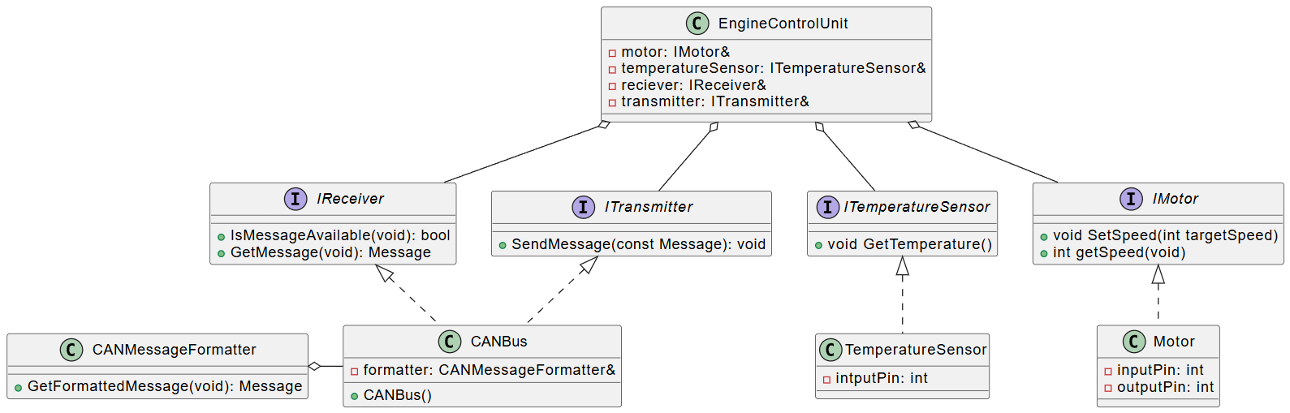
Engine control unit

Slide 9
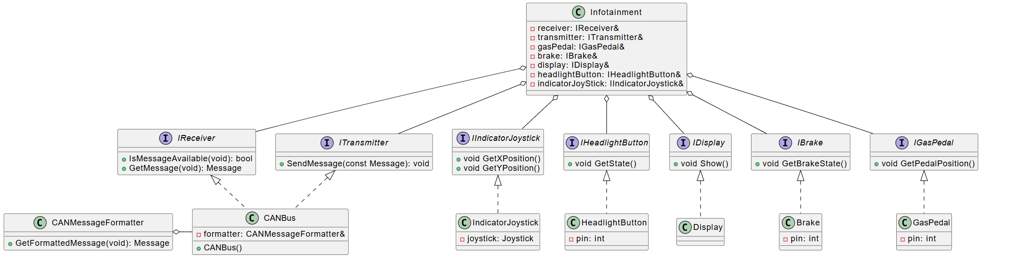
Infotainment

Slide 10
Questions?

